Slide 1
Agile metrics in Action
Banglore, 17/04/2019,Aitipamula Harika

Slide 2
Table of content:
Measuring agile performance
Collect, measure, react, repeat—the feedback loop
What are metrics?
Project-tracking systems
Trends and data from project-tracking systems
Source control
Key SCM metrics
Trends and data from source control
The build system
Key CI metrics
System monitoring
Data from your production systems
Visualizing the data

Slide 3
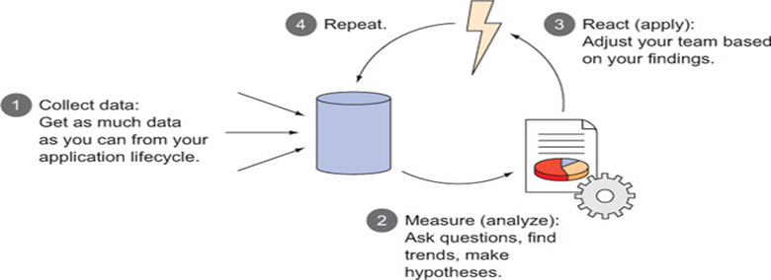
Measuring agile performance
Collect, measure, react, repeat—the feedback loop
Collect —Gather all the data you can about your team and performance. Understand where you are before you change anything.
Measure —Analyze your data.
Look for trends and relationships between data points.
Formulate questions about your team, workflow, or process.
Determine how to adjust based on your analysis.
React —Apply the adjustments based on your analysis.
Repeat —Keep tabs on the data you’ve determined should be affected so you can continuously analyze and adjust your team.

Slide 4
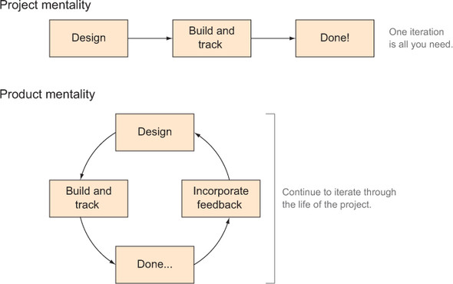
Measuring agile performance
Why agile teams struggle with measurement

Slide 5
What are metrics?
The data you can get from your application lifecycle as it applies to the performance of software development teams. A metric can come from a single data source or it can be a combination of data from multiple data sources. Any data point that you track eventually becomes a metric that you can use to measure your team’s performance. Examples of common metrics are:
Velocity —The relative performance of your team over time
Changed lines of code (CLOC) —The number of lines of code that were changed over time
These metrics in effect become key performance indicators (KPIs) that help measure what’s important to your team and your business.

Slide 6
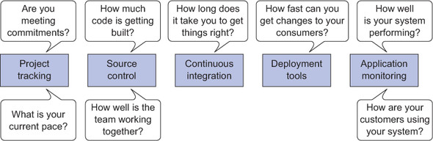
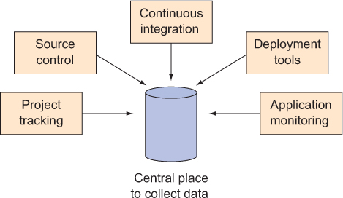
Measuring agile performance
What questions can metrics answer, and
where do I get the data to answer them?

Slide 7
Project-tracking systems
Typical agile measurements using PTS data
Tools like JIRA Agile, Axosoft OnTime, LeanKit, TFS, Telerik TeamPulse, Planbox,
and FogBugz can all track your agile team, and all have APIs you can tap into to
combine that data with other sources to help you track the common agile metrics.
Turning subjective to objective
Example:
Recidivism tells you how frequently your team is moving the wrong way in your workflow.
It’s calculated purely with PTS data with the following formula:
Recidivism = bN / (fN + bN)

Slide 8
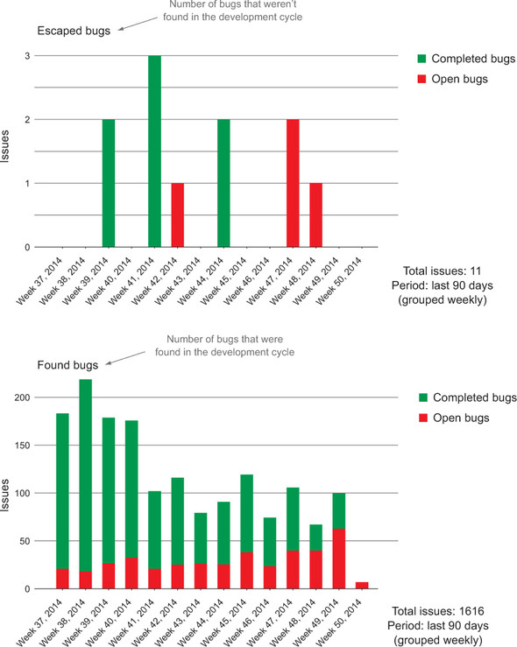
Trends and data from project-tracking systems
Lead time
Lead time is the amount of time between
when a task is started and when it is
completed.
Bug counts
Bugs represent inconsistencies in your
software. Different teams will have different
definitions of what a bug is, ranging from
a variation from your application’s spec to
unexpected behaviors that get noticed after
development is complete.

Slide 9
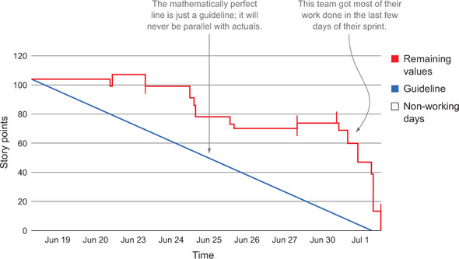
Trends and data from project-tracking systems
Burn down
The burndown chart shows the total effort against the amount of work for each iteration.
It does provide a guideline to where you are against your commitment for a time
period

Slide 10
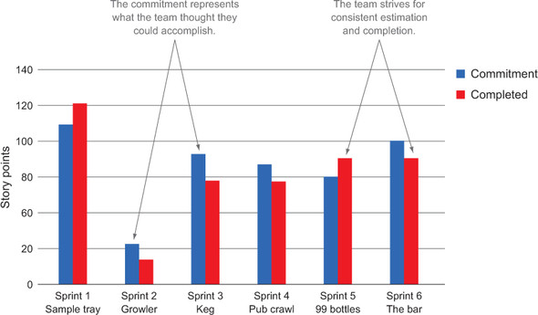
Trends and data from project-tracking systems
Velocity
Velocity is a relative measurement that tracks the consistency of a team’s completed estimates over time. The idea with velocity is that a team should be able to consistently complete their work as they define it.
Velocity ends up implying a few things about your team:
How good your team is at estimating work
How consistently your team gets work
done
How consistently your team can make and
meet commitments

Slide 11
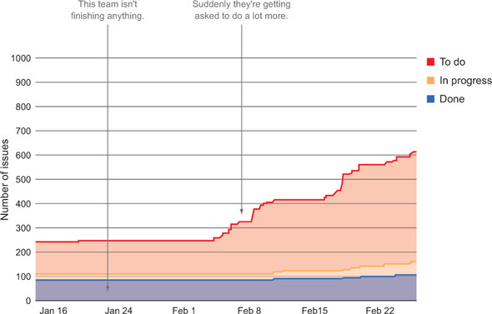
Trends and data from project-tracking systems
Cumulative Flow
Cumulative flow shows how much work aggregated by type is allocated to your team over time. The cumulative flow diagram is typically used for identifying bottlenecks in the process by visually representing when a type of task is increasing faster than the others.
An example cumulative flow diagram showing a team getting asked to do a lot more than they have been able to accomplish historically

Slide 12
Source control
Typical agile measurements using source control data
Source control is where the actual work is done and collaboration across development teams happens. From here you can see which files are changing and by how much. Some source control systems allow you to get code reviews and comments, but in other cases you need additional systems to get that type of information. Tools like Stash, Bitbucket, and GitHub have rich REST-based APIs that can get you a wealth of information about your codebase.
Here are two questions you can answer from source control alone:
How much change is happening in your codebase?
How well is/are your development team(s) working together?

Slide 13
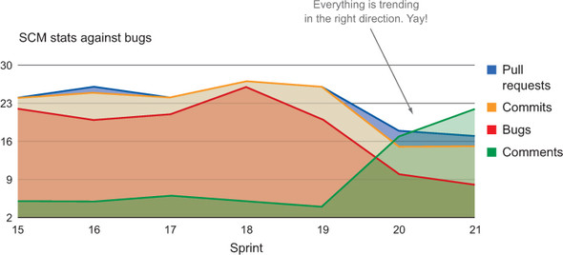
Key SCM metrics
Pull requests
Denied pull requests
Merged pull requests
Commits
Reviews
Comments
CLOC (helps calculate risk)

Slide 14
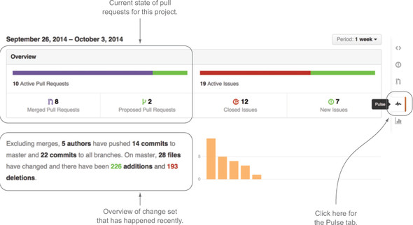
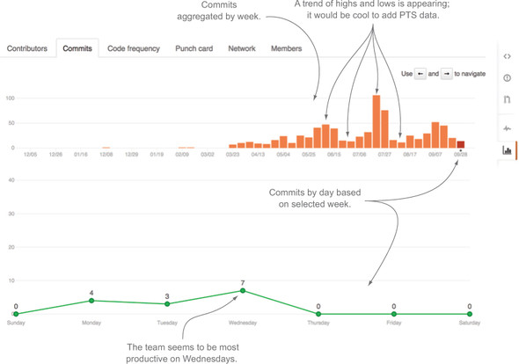
Trends and data from source control
Pull requests, issues, and amount
of change.
commits to this repository

Slide 15
The build system
After someone checks something into source control, it typically goes into your build system, which is where the code from multiple check-ins is integrated, unit tests are run, your code is packaged into something that can be deployed somewhere, and reports are generated. All of this is called continuous integration (CI).
From here you can get lots of great information on your code: you can see how well your team’s changes are coordinated, run your codebase against rule sets is an essential part of team software development, check your test coverage, and see automated test results.
There are several systems that help you get going quickly, including Urban Code build, TeamCity, Jenkins, Hudson, and Bamboo.
Some teams have taken CI past the integration phase and have their system deploy their code while they’re at it. This is called continuous delivery (CD).
Whether you’re doing CI or CD, the main thing you need to care about is the information that is generated when your code is getting built, inspected, and tested.
Here are questions you can answer from CI alone:
How fast are you delivering changes to your consumer?
How fast can you deliver changes to your consumer?

Slide 16
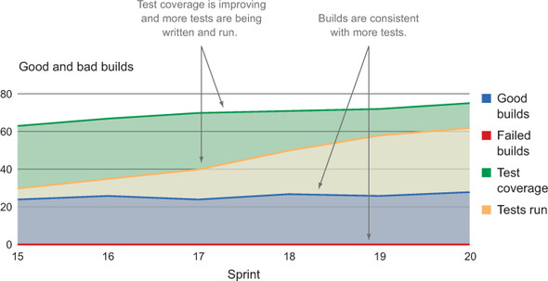
Key CI metrics
Test reports
Total number of tests
Percentage of passing and failing tests
Static analysis
Test coverage percentage
Code violations
Successful versus failed builds
How well is your code review process working?
How good is your local development environment?
Is your team thinking about quality software?
How frequently do you get updates in front of your consumers?

Slide 17
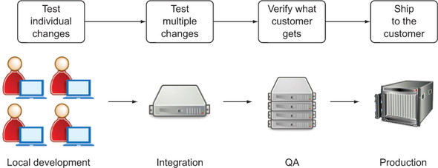
System monitoring
Once your code goes into production, you should have some type of system that looks at it to make sure it’s working and that tells you if something goes wrong, such as whether a website becomes unresponsive or if your mobile app starts to crash every time a user opens it. If you’re doing a really great job with your testing, you likely are paying attention to your system monitoring during your testing phase as well making sure you don’t see any issues from a support perspective before your code goes into production.
Here are questions you can answer from your production-monitoring systems:
How well is your code functioning?
How well are you serving the consumer?

Slide 18
Utilizing the features of your application performance monitoring system
These allow you to monitor things like the following:
Network connections
CPU
Memory usage
Transactions
Database connections

Slide 19
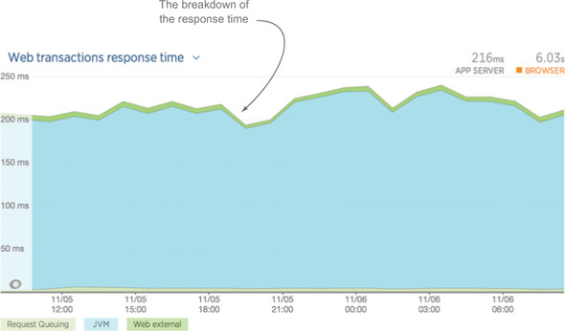
Data from your production systems
Health statistics
CPU usage
Heap size
Error rates
Response times
Semantic loggings
How your consumers are using your system is
key to continuously improving it. If you’re
collecting arbitrary metrics and page tracking,
then there’s no limit to what you can learn
about your consumers and how they use your
system.
Note that the metrics displayed are arbitrary metrics defined in the code of the application.

Slide 20
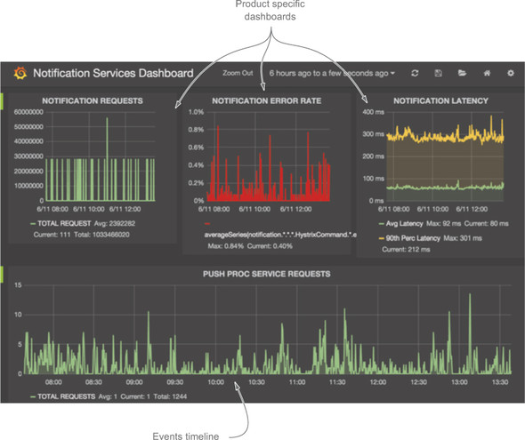
Data from your production systems
A screenshot of Grafana, the web front end for the Graphite time-series database. Note that the metrics displayed are arbitrary metrics defined in the code of the application.
you can see metrics that the team made up and are tracking to see how their consumers are using the site.

Slide 21
Visualizing the data
Data is such a part of the fabric of how business is done today that there is a plethora of frameworks for visualizing it. Ideally you should use a distributed system that allows everyone access to the charts, graphs, radiators, dashboards.
Asking everyone in your company to query that data from a command line probably isn’t the best approach to communicate effectively.

Slide 22
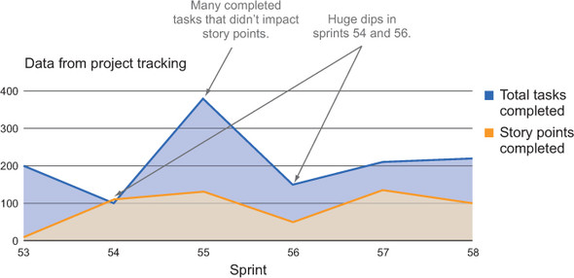
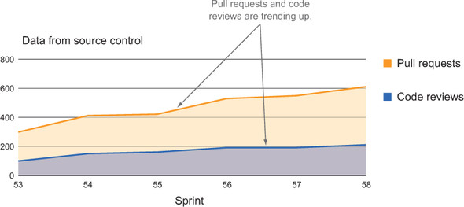
Visualizing your data
Project tracking data for a team for a few sprints
Source control data for a team over a few sprints

